Slide 1
TPOT Letters

Slide 2
Goals
Move the current functionality of TPOT Letters into an updated desktop application.
Improve on current features such as Date and Author detection, as well as manual editing.
Add features such as updates or email reversals, over time.

Slide 3
New features
Convert raw (RTF) Letters text from MS Word to HTML format for posting on WordPress.
Preview a Letter online* (with local browser or internal, not sure yet)
Keep a local cache of Letters worked on or ready for submission.

Slide 4
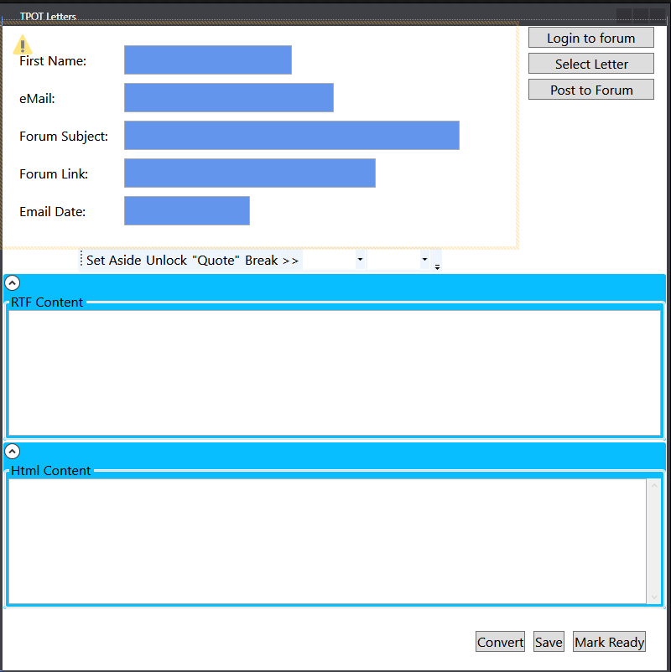
Completed work / WIP
RTF to HTML conversion working, but needs tidying up (automatic).
Mockup of the original TPOT Letters. Done.
Converting RTF hyperlinked urls to Html url tags. (automatic)

Slide 5
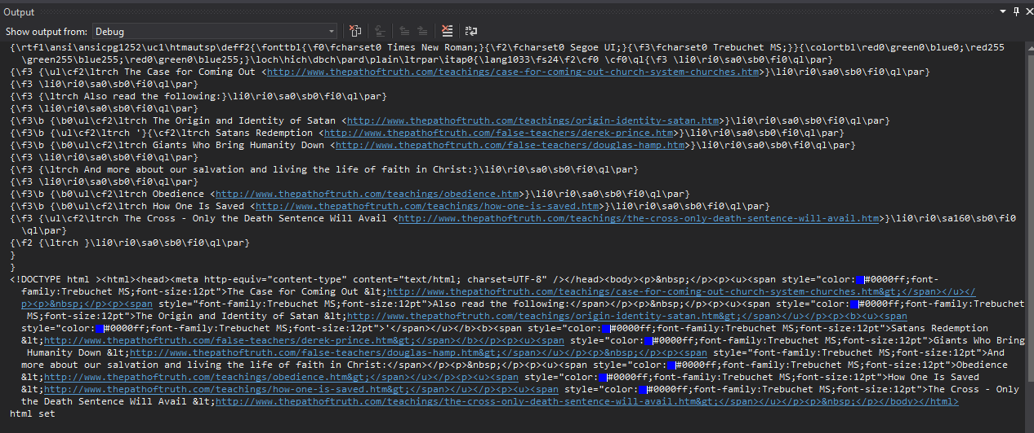
SAMPLE Conversion
This is to show the Proof of Concept works:
The top half is RTF/Word format.
The bottom half (<!Doctype> and onward) is the more recognizable HTML format.

Slide 6
Considerations
Needs: Testers. These can be anyone technical or not.
Bug reporting: If anyone sees an issue, notify Michael or Ronnie on Trello. Please provide descriptions* of:
What you were doing or intended to do, and expected to see.
A screenshot (be in the habit of taking them with Windows Snip or Print Screen + Paint, etc.)
What you actually saw happen.
*These descriptions, done with care, are incredibly valuable for developers and are appreciated greatly.
Distribution: We need a place to publish this application as well as to download it, so everyone working on letters may use it.
This will be developed initially for Windows.

